Slide 1
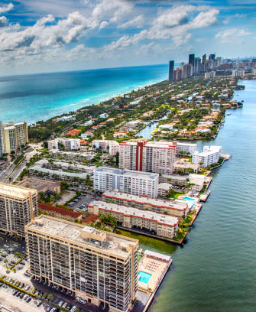
W209 Final Presentation
April 11, 2022
Heather Rancic, Irene Shaffer,
Luis Delgado, Tony Angell,
Austin Jin
Notes:
TONY

Slide 2
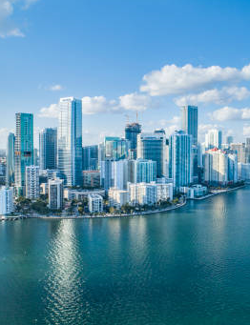
Project Overview
Miami Dade Real Estate
Our final presentation seeks to understand the drivers behind Miami real estate costs as they pertain to future investments in the area.
2016 - ~14k single family homes
FRED - economics
Notes:
TONY
Talk about the dataset, below:
Our real estate dataset is from 13,932 single family home sales in Miami throughout the year in 2016. We examined the FRED economic data to have a rudimentary understanding on the economic status of real estate sales in 2016. Were they affected by any larger U.S. economic factors (i.e. the home sales crash of 2007-2010) affecting real estate sales? We noted that 2016 was right in the heart of the last decade’s linear increase in real estate prices.

Slide 3
Midterm Tasks and Goals
Realistic, Actionable, Intuitive
How does sea level rise impact housing prices?
How does proximity to noise impact housing prices?
A buyer is looking for a large home, can they use price per square foot to gauge the comparable costs of property?
A buyer is looking for ocean front property, how many square feet can they expect with a $1.5 mil budget?
Notes:
TONY - next slide Irene will talk about

Slide 4
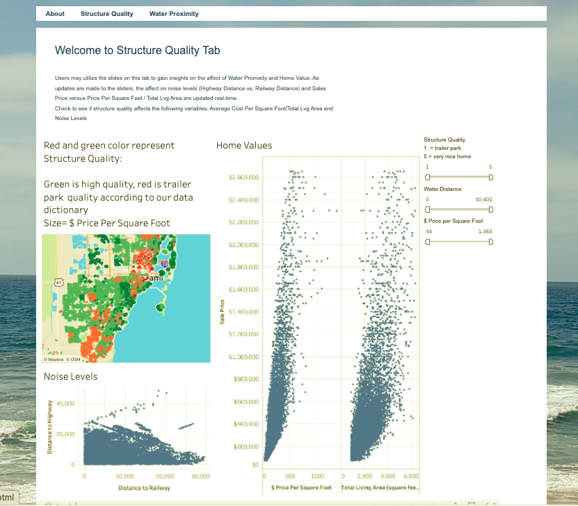
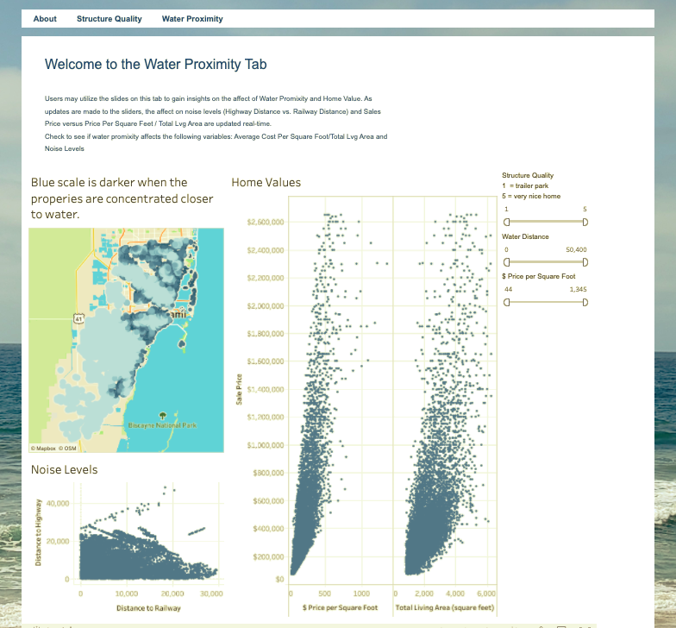
Overall Design
Notes:
IRENE
Two tabs, for Structural Quality and for Water Proximity.
Explain why you made the choices you made to get the current design. Iterating on home prices by sq feet and proximity to the ocean, overlaying with a map showing cities gives clearer context of location. Additionally, adding in the home prices to the visualization helps with insights on pricing vs. location.

Slide 5
Usability Study Prototype
15 Participants in our usability study
Test Tasks
Which region of Miami has the most expensive real estate per SF?
Which region of Miami has the highest structure quality?
Which region is the best value considering structure quality and price per SF?
Are you able to determine the areas with a higher threat for sea level rise based on proximity to water?
Are you able to determine if real estate cost increases or decreases with proximity to water?
Debriefing Questions
What was the most confusing part of this tool?
What, if anything would you improve on the dashboards?
If you needed to review real estate in Miami, would you continue utilizing our dashboard? Why or not?
Were you surprised by anything you found today?
Likert Scale Questions
Using a scale 1 (strongly disagree) to 3 (neither agree nor disagree) to 5 (strongly agree):
I feel this dashboard is intuitive for gaining insights.
I found it’s easy to tell the difference between a high-and-low quality structure.
I would recommend this visualization to someone trying to buy a house in the Miami area.
Notes:
IRENE - Next Heather will talk about usability study results and some improvements

Slide 6
Usability Study Results
MoSCoW: Common themes across usability participants
M - Must Have:
PricePerSqFt, Water Dist , please spell it out, wasn’t sure what it meant
Making sure that the colors/sizes of the points on the map matches the scatterplots.
Users confused about what dots, colors, and size mean. Didn't realize that size of dot is related to price per SF and that color is structure quality.
Fix color scheme when filtered.
S-Should Have:
Red / Green bubble key, which is which?
Users confused how to reset the map filter.
C - Could Have:
Adding in areas to the points on the scatterplot.
Add home price and noise level to tool tip
W - Would Not Have
This was a very clear visual, don’t add more, it could look like clutter, because its quite clear already
User want more information related to average age to understand the relationship with real estate prices and concentrations of student housing near the local university.
Notes:
HEATHER
Try not to go into detail regarding the specific addressed issues via the MoSCoW method, rather use this to talk about our MoSCoW process, how many people we interviewed, how we used this method to collate the data and come up with actionable items.

Slide 7
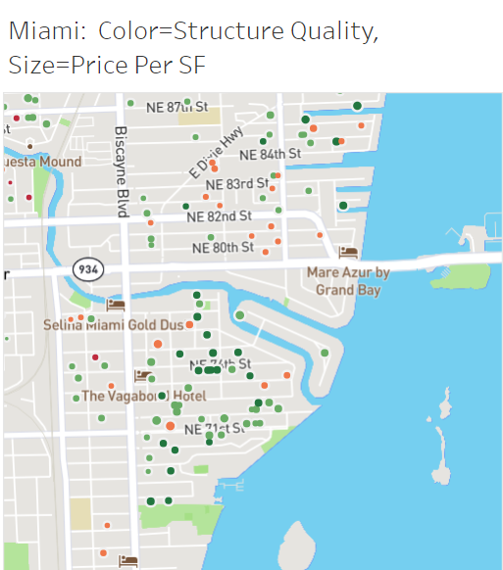
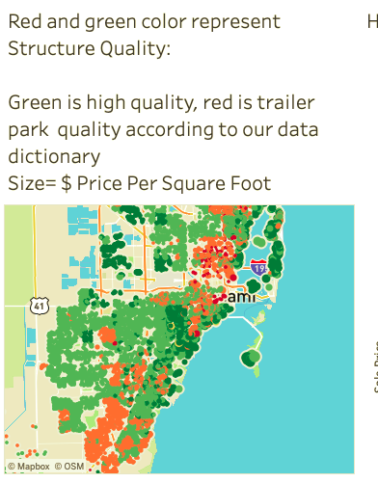
Improvements
ISSUES | IMPLEMENTED SOLUTIONS
Red vs green dots confusing | Added text to explain the meaning of the red vs green dots
Notes:
HEATHER - now Austin will tell us about some other improvements

Slide 8
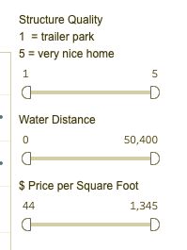
Improvements
ISSUES | IMPLEMENTED SOLUTIONS
No sliders on water proximity dashboard | Added sliders for easier navigation
Notes:
AUSTIN

Slide 9
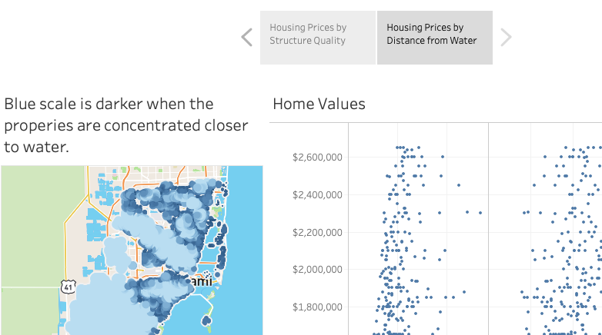

Improvements
ISSUES | IMPLEMENTED SOLUTIONS
One Storyboard Tab vs. Separate Tabs | Just because you can, doesn’t mean you should… we created a story with Tableau but found that implementing via HTML was easier for the user experience. We were careful to consider our technology choice to make the user experience as easy and intuitive as possible, and not to ‘over engineer’ the solution. Created two tabs (Structure Quality and Water Proximity) Also attached the storyboard dashboard that has both Structure Quality and Water Proximity in the About tab
Notes:
AUSTIN -are you ready for a demo? Luis, take it away

Slide 10
Final Visualization Sample Walk Through
https://people.ischool.berkeley.edu/~hrancic/
Notes:
LUIS
Go through a sample zoom in, find, and informational use of our page

Slide 11
Questions
Notes:
LUIS

Slide 12
Appendix and Additional Slides

Slide 13
Final Project Presentation and Report
You will give a demonstration of your visualization in action for your classmates during the discussion section. Like the mid-term presentations, you will have 15 minutes. This demonstration is your chance to show your fellow students how far your design has come since the mid-term milestone. Tell us what you changed and why. You must include details and conclusions from at least one round of usability testing (with at least three different subjects).Tell how your design changed in response to your findings. Also address your choice of tools for building the final interactive visualization. All team members must participate in the presentation.
Project Web Report & Video
One team member must submit the URL for the final version of the project web site and a breakdown of which group members undertook which tasks through the ISVC. Include any additional information you would like your instructor to be aware of, changes you would have made if you had more time, such as information you didn't have time to include in the final presentation. Include a link to a 2-3 minute video demo of the visulization posted to YouTube (this serves to memorialize the project to share with future classes - and you can share this for your own portfolio).
The project web site itself must include (a) an interactive visualization, and (b) explanatory text to accompany the interactive visualization. Text should include the names of team members, the visualization’s goals, its intended audience, and the data source(s). This may be included as an About page or integrated with the visualization itself, as appropriate. Use the I School web servers for the final project; see instructions for using your I School web site. Each group is expected to share a description, link, and screencapture image of their project through the I School Projects page for posterity: https://www.ischool.berkeley.edu/node/add/stpr. Please do select the course and section. Students who use Amazon or another service that will not remain live are expected to make a video walkthrough of the site and to include this in their post.

Slide 14
Grading for Final Projects
Your instructor will consider the final presentations, the web site, and any additional information you provide in the final paper in determining a single grade for the final project.
12 points - Is the final product of appropriate form?
12 points - Does it successfully solve a problem or inform the user?
12 points - Is the explanatory text clear?
12 points - Did you show substantial iteration?
10 points - Can the visualization be understood without too much effort?
10 points - Is it aesthetically pleasing?
10 points - Did you include results of usability testing?
8 points - Did you present data in a novel way?
8 points - Did you explain your choice of tools?
6 points - Did everyone in your group participate?

Slide 15
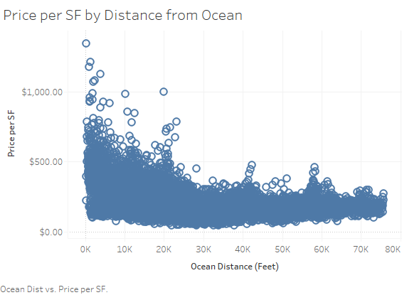
Iteration 1: The threat of Sea Level Rise (SLR) has a negligible impact on home sale prices.
Notes:
IRENE: Here are the raw data points. See a general trend, but we want to understand more.

Slide 16
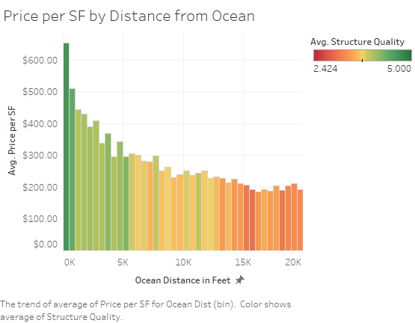
Iteration 2: The threat of Sea Level Rise (SLR) has a negligible impact on home sale prices.
Notes:
IRENE: Added bins for ocean distance to see the trend more clearly. Also, colored by structure quality to see if this may also explain the difference in price per SF. We see that the structure quality goes down as we move farther away from the ocean. So the question is, does distance from the ocean still affect price per SF if we hold the structure quality constant?

Slide 17
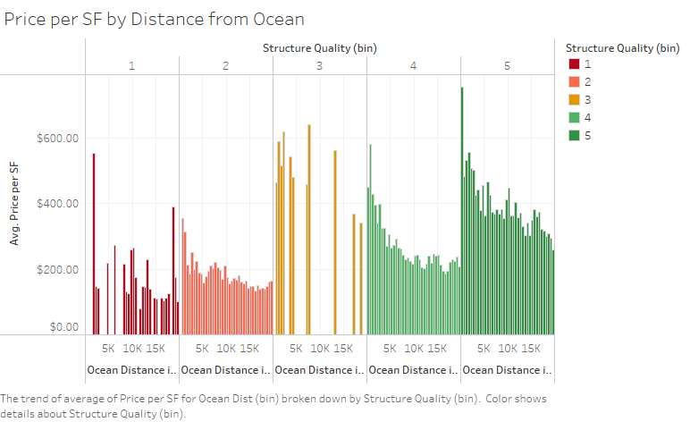
Iteration 3: The threat of Sea Level Rise (SLR) has a negligible impact on home sale prices.
Notes:
IRENE: Here we separated structure quality into bins. So we can see the trend for a fixed structure quality. Within each bin, we can see that price per SF is still strongly dependent on distance from the ocean. So, it is not only a factor of structure quality. And now Tony will discuss our second task.

Slide 18
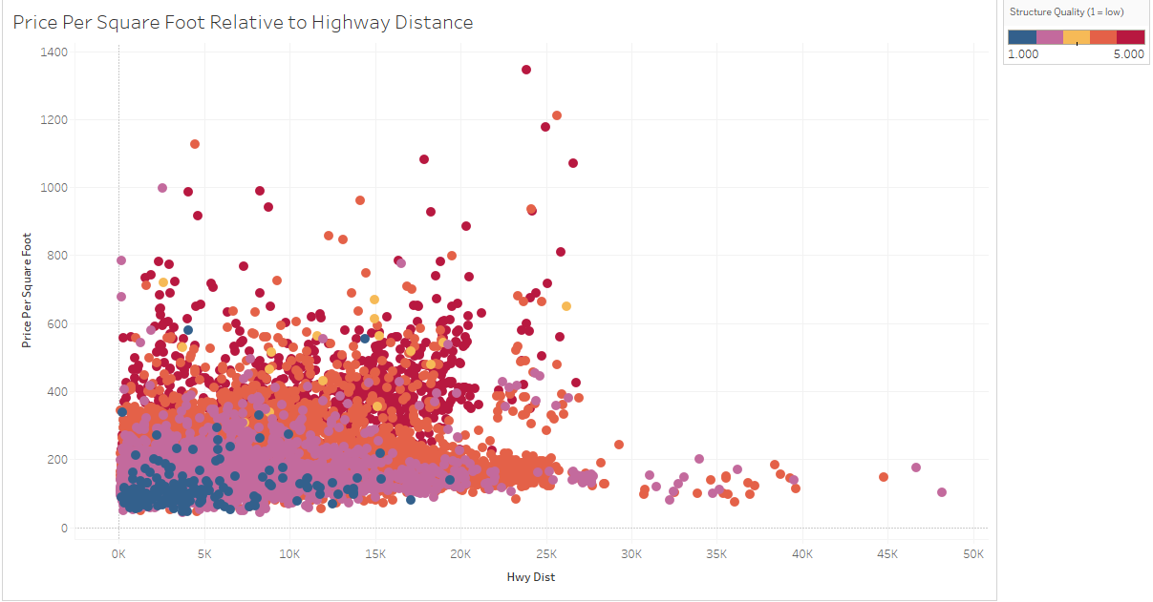
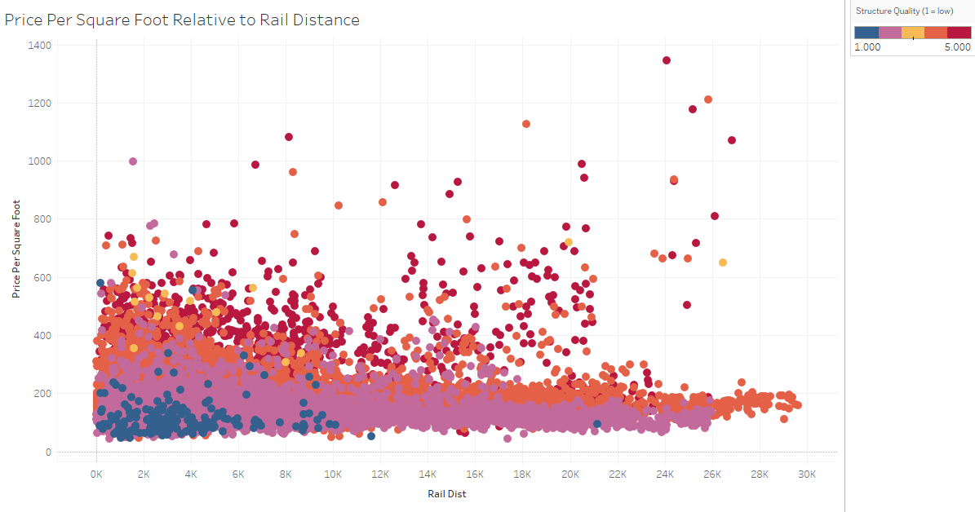
Iteration 1: Proximity to noise has a significant effect on comparable home sales
Notes:
Tony

Slide 19
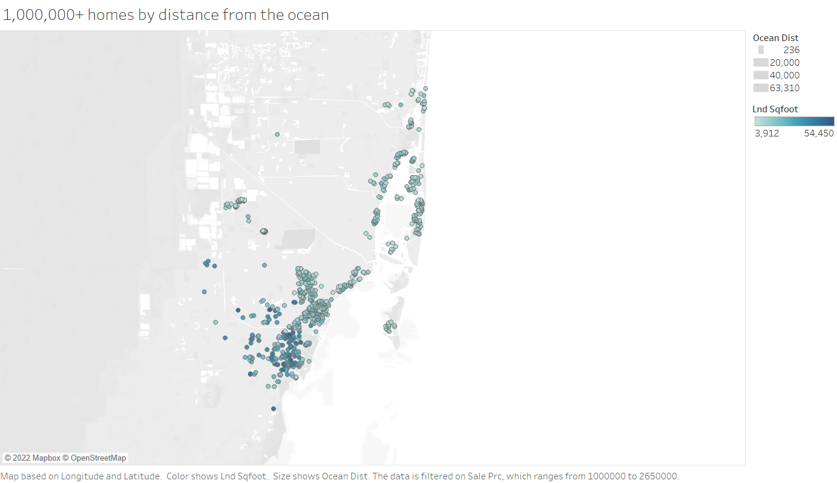
Iteration 1: Home prices are more expensive near the ocean with larger homes being more affordable further away from the ocean.
Notes:
Heather - explain why you made the choices you made to get the current design. Buyers in the Miami area who are looking for $1M + homes have considerations to make based on how much sq feet they would like vs. how close to the ocean they would like to live. The results from the chart show visually that the distance from the ocean does in fact have an impact on the price per square foot. It seems that home prices are more expensive if near the ocean compared to home prices that are further away from the ocean. As we can see from the chart, the price per square feet increases as the house is distanced closer to water.

Slide 20
Data Sources and References
Miami Housing Dataset:
https://www.kaggle.com/deepcontractor/miami-housing-dataset
Miami-Dade County 3-D Sea Level Rise (SLR) impacts:
https://mdc.maps.arcgis.com/apps/webappviewer3d/index.html?id=b92a9fa4ff8847bf97f3e628a195a398
Miami-Dade County Sea Level Rise (SLR) predictions:
https://southeastfloridaclimatecompact.org/wp-content/uploads/2020/04/Sea-Level-Rise-Projection-Guidance-Report_FINAL_02212020.pdf
Images:
Miami Dade skyline : https://www.istockphoto.com/search/2/image?phrase=miami+skyline
https://www.gettyimages.com/photos/miami-dade-county

Slide 21
Team Member Names & E-mails
Heather Rancic (hrancic@ischool.berkeley.edu)
Irene Shaffer (irene.shaffer@ischool.berkeley.edu)
Luis Delgado (luispdelgado@ischool.berkeley.edu)
Tony Angell (tangell@ischool.berkeley.edu)
Austin Jin (azj5160@berkeley.edu)

Slide 22
Tasks, Data and Users
Overall tasks | Supporting Data | Audience
The threat of Sea Level Rise (SLR) has a negligible impact on home sale prices. | ●Price per Sq Ft ●Ocean Distance | Irene
Proximity to noise has a significant effect on comparable home sales | ●Price per Sq Ft ●Highway Distance
Home prices are more expensive near the ocean with larger homes being more affordable further away from the ocean. | ●Home Price over $1M ●Price per Sq Ft ●Ocean Distance
Notes:
Luis

Slide 23
Usability Testing Approach
Realistic, Actionable, Intuitive
How does sea level rise impact housing prices?
How does proximity to noise impact housing prices?
A buyer is looking for a large home, where will they find the most value per sq. feet?
A buyer is looking for ocean front property, how much sq. feet can they expect with a $1.5 mil budget?
Notes:
Austin

Slide 24
Hypotheses
1. The threat of Sea Level Rise (SLR) has a negligible impact on home sale prices.
2. Proximity to noise has a significant effect on comparable home sales.
3. Home prices are more expensive near the ocean with larger homes being more affordable further away from the ocean.
Notes:
Austin’s slide

Slide 25
Derived Insights
Hypothesis 1: As we can see from the chart, the price per square feet decreases as the house is distanced further away from water, and this trend remains even when holding structure quality constant.
Hypothesis 2: It looks like rail and highway distance do not strongly indicate an effect from noise on price.
Hypothesis 3: As we can see from the chart, the price per square feet increases as the house is distanced closer to water.

Slide 26
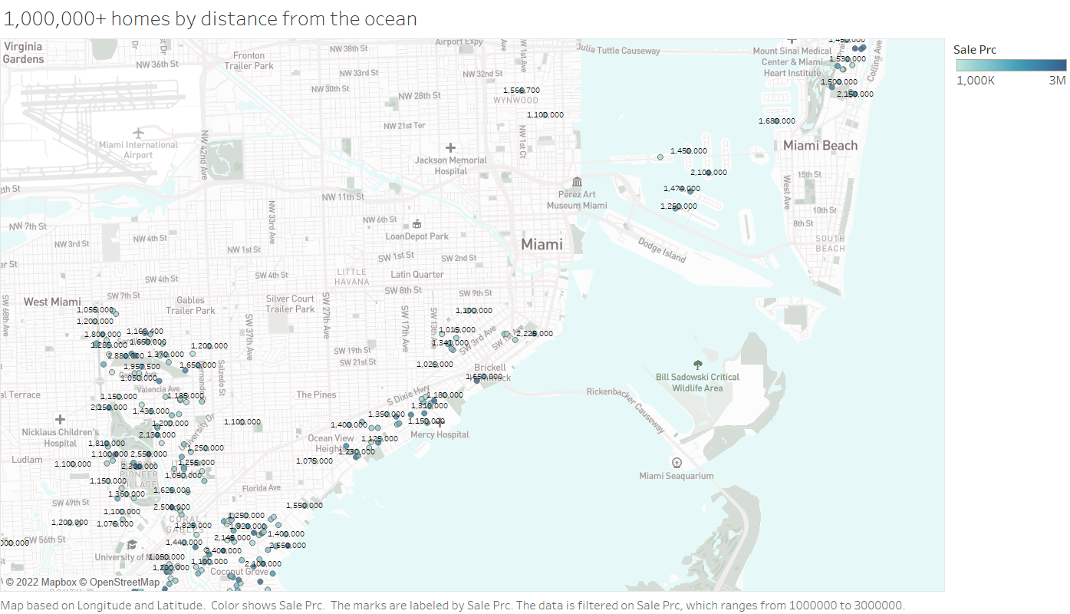
Preliminary Design Approach
Overall Design:Home prices are more expensive near the ocean with larger homes being more affordable further away from the ocean.
Rationale: some rationale here
Notes:
IRENE
explain why you made the choices you made to get the current design. Iterating on home prices by sq feet and proximity to the ocean, overlaying with a map showing cities gives clearer context of location. Additionally, adding in the home prices to the visualization helps with insights on pricing vs. location.

